Slide 1
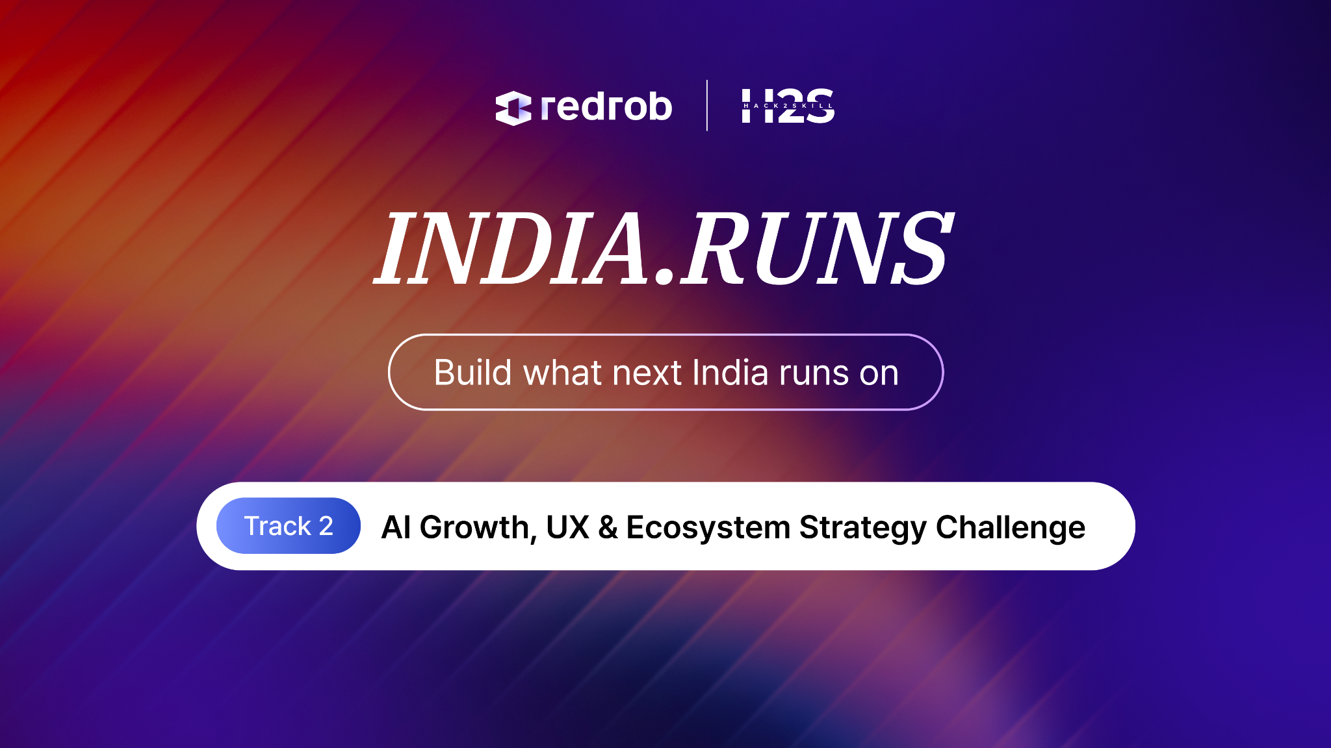

Slide 2

Redrob Context & Ideathon Scope
Redrob AI is building an AI-native ecosystem spanning hiring, productivity, communication, discovery, workflows, recommendations, automation, and intelligent user experiences.
Participants are encouraged to think beyond standalone applications and explore how their ideas can:
Extend existing Redrob capabilities
Improve experiences for Redrob users
Introduce new AI-native workflows
Strengthen ecosystem engagement and network effects

Slide 3

Important
Participants are not expected to build a completely new platform from scratch.
Strong submissions will demonstrate:
How the idea leverages existing Redrob capabilities
What new capability, workflow, or value layer is introduced
How the idea strengthens the overall Redrob ecosystem
Why Redrob is uniquely positioned to enable this experience

Slide 4
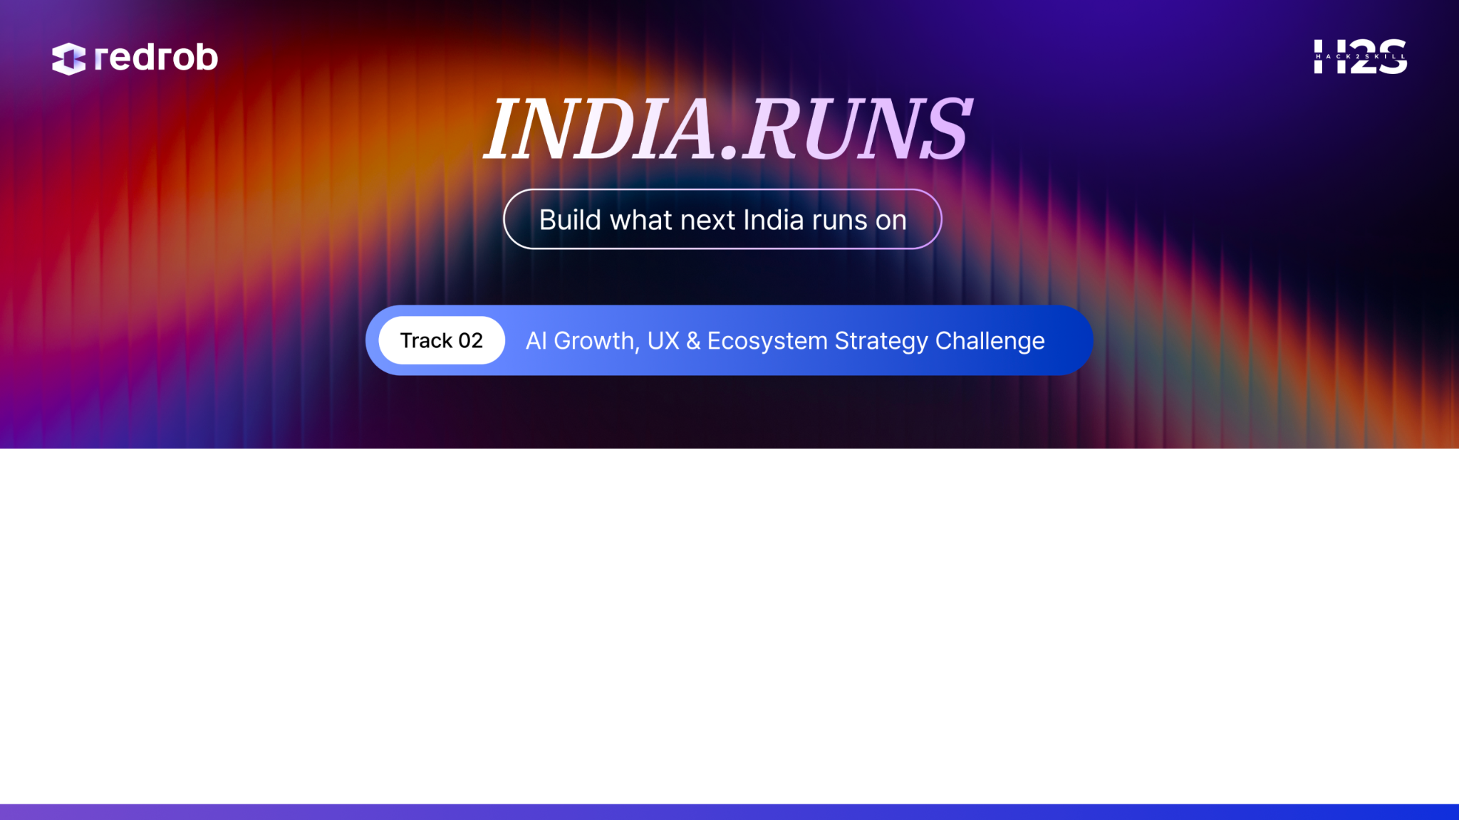
Team Name : Cyber Crusaders
Problem Statement :
Team Members : Alan John , Sudipta Sanki

Slide 5
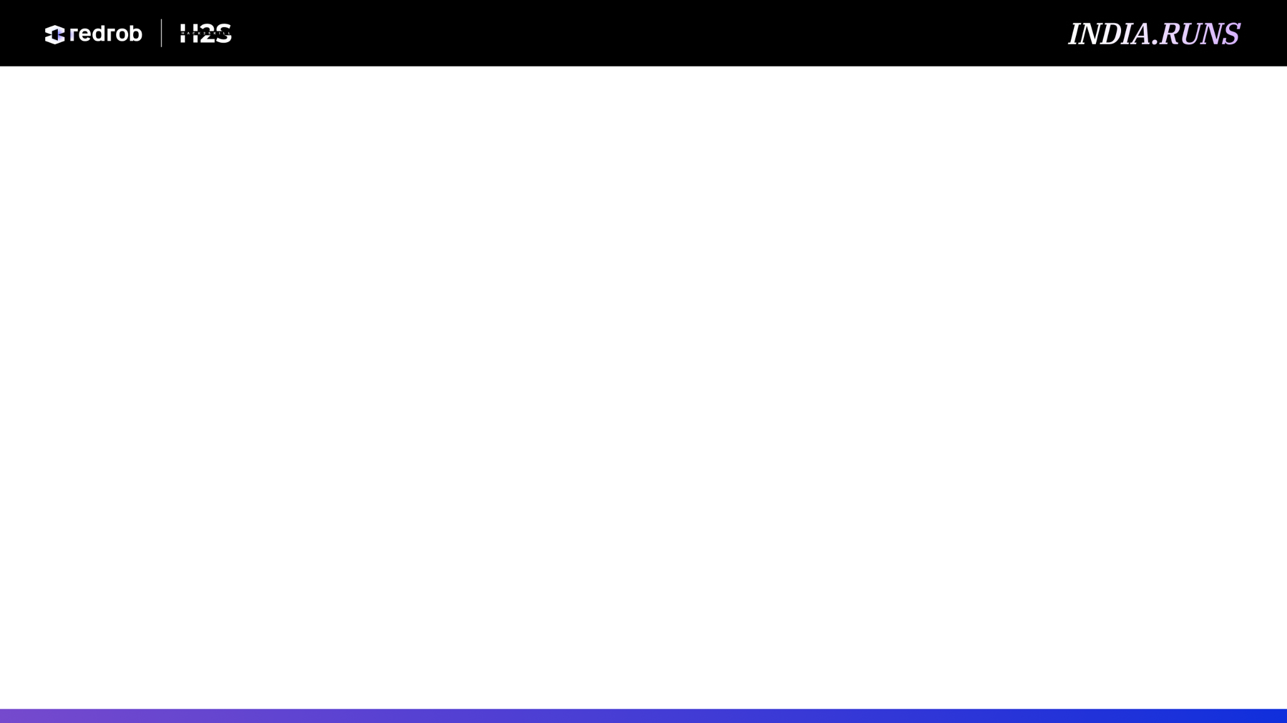
Problem & User Insight
Questions
What adoption, engagement, trust, retention, or monetization challenge are you addressing?
What evidence or observations support this?
Why is this an important opportunity for Redrob?

Slide 6
Audience & Persona Analysis
Questions
Who is the target audience?
What motivates them?
What barriers exist today?
Mandatory Visual
Persona Framework

Slide 7
Proposed Solution / Strategy
Questions
What is your proposed feature, strategy, program, or ecosystem enhancement?
Why is it differentiated?
Which Redrob user journey, experience, or business objective does it improve?

Slide 8
User Journey & Experience Design
Questions
How does a user discover, onboard, engage, and derive value?
Where does the proposed intervention occur within the Redrob experience?
How does the experience improve?
Mandatory Visual
User Journey Map

Slide 9
Experience Mockups / Wireframes
Questions
What would the experience look like?
How does it fit within Redrob?
How would users interact with it?
Mandatory Visual
Mockups / Wireframes

Slide 10
Growth & Engagement Model
Questions
How does the solution drive acquisition, activation, retention, referral, or revenue?
What loops or mechanisms are created?
Mandatory Visual
Growth Funnel / Growth Loop Diagram

Slide 11
Redrob Ecosystem & Platform Impact
Questions
Which Redrob stakeholders benefit?
How does the idea improve engagement, trust, retention, monetization, or growth?
What ecosystem effects are created?
Mandatory Visual
Ecosystem Flywheel Diagram

Slide 12
Business Model & Monetization
Questions
What business value is created?
How does the idea contribute to platform growth?
What monetization or retention opportunities emerge?

Slide 13
Rollout & Adoption Strategy
Questions
How would the solution be launched?
How would users be educated and onboarded?
What assumptions need validation?
Recommended Visual
Rollout Roadmap

Slide 14
Success Metrics
Questions
What KPIs define success?
How will user and business impact be measured?

Slide 15
Future Vision
Questions
What does success look like in 3 years?
How could the Redrob ecosystem evolve because of this initiative?

Slide 16
